Slide 1
Unit 3

Slide 2
Area Filling
3.1 Polygon Filling
3.1.1 Seed Fill
3.1.1.1 Boundary Fill Algorithm
3.1.1.2 Flood Fill Algorithm
3.1.2 Scan Line Algorithm

Slide 3
Area filling or Region filling is the process of filling image or region.
Filling can be of boundary or interior region as shown in fig.
Boundary Fill algorithms are used to fill the boundary and flood-fill algorithm are used to fill the interior.

Slide 4
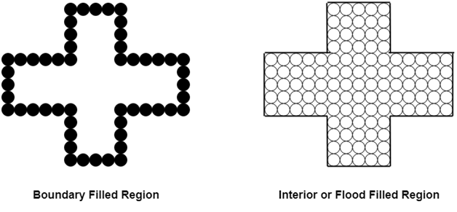

Slide 5
Boundary Fill Algorithm
This algorithm picks a point inside the polygon and starts to fill until it hits the boundary of the object.
Assumption:
In this algorithm, we assume that color of the boundary is same for the entire object.

Slide 6
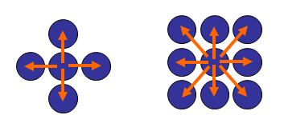
Boundary Fill Algorithm
The boundary fill algorithm can be implemented by 4-connected pixels or 8-connected pixels.

Slide 7
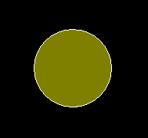
In this image boundary is filled with white color and interior color is green.

Slide 8
Boundary Fill Algorithm starts at a pixel inside the polygon to be filled and paints the interior proceeding outwards towards the boundary.
This algorithm works only if the color with which the region has to be filled and the color of the boundary of the region are different.
If the boundary is of one single color, this approach proceeds outwards pixel by pixel until it hits the boundary of the region.

Slide 9
1. Four connected approaches: In this approach, left, right, above, below pixels are tested.
2. Eight connected approaches: In this approach, left, right, above, below and four diagonals are selected.

Slide 10
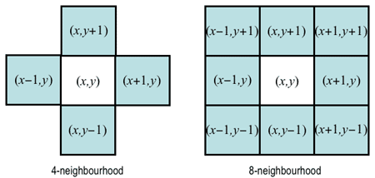

Slide 11
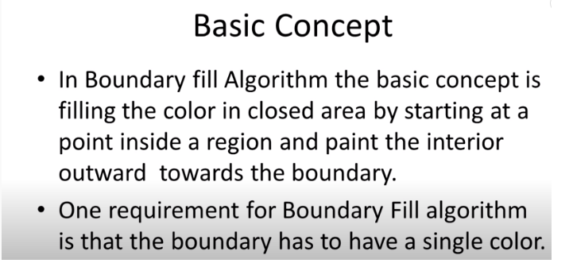

Slide 12
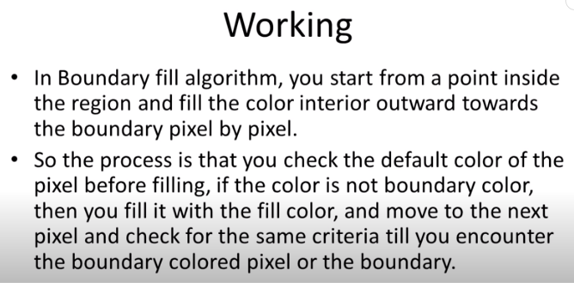

Slide 13
Boundary Fill Algorithm is recursive in nature.
It takes an interior point(x, y), a fill color, and a boundary color as the input.
The algorithm starts by checking the color of (x, y). If it’s color is not equal to the fill color and the boundary color, then it is painted with the fill color and the function is called for all the neighbours of (x, y).
If a point is found to be of fill color or of boundary color, the function does not call its neighbours and returns.
This process continues until all points up to the boundary color for the region have been tested.
The boundary fill algorithm can be implemented by 4-connected pixels or 8-connected pixels.

Slide 14
4-connected pixels : After painting a pixel, the function is called for four neighboring points.
These are the pixel positions that are right, left, above and below the current pixel. Areas filled by this method are called 4-connected. Below given is the algorithm :
Algorithm :

Slide 15
Algorithm 4 connected
void boundaryFill4
(int x, int y, int fill_color,int boundary_color)
{
if(getpixel(x, y) != boundary_color &&
getpixel(x, y) != fill_color) {
putpixel(x, y, fill_color);
boundaryFill4(x + 1, y, fill_color, boundary_color);
boundaryFill4(x, y + 1, fill_color, boundary_color);
boundaryFill4(x - 1, y, fill_color, boundary_color);
boundaryFill4(x, y - 1, fill_color, boundary_color); }
}

Slide 16
8-connected pixels : More complex figures are filled using this approach.
The pixels to be tested are the 8 neighboring pixels, the pixel on the right, left, above, below and the 4 diagonal pixels.
Areas filled by this method are called 8-connected. Below given is the algorithm :

Slide 17
Algorithm :
void boundaryFill8(int x, int y, int fill_color,int boundary_color)
{
if(getpixel(x, y) != boundary_color &&
getpixel(x, y) != fill_color)
{
putpixel(x, y, fill_color);
boundaryFill8(x + 1, y, fill_color, boundary_color);
boundaryFill8(x, y + 1, fill_color, boundary_color);
boundaryFill8(x - 1, y, fill_color, boundary_color);
boundaryFill8(x, y - 1, fill_color, boundary_color);
boundaryFill8(x - 1, y - 1, fill_color, boundary_color);
boundaryFill8(x - 1, y + 1, fill_color, boundary_color);
boundaryFill8(x + 1, y - 1, fill_color, boundary_color);
boundaryFill8(x + 1, y + 1, fill_color, boundary_color);
}
}

Slide 18
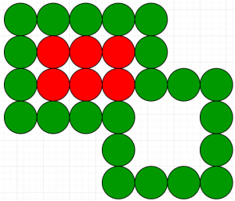
4-connected pixels Vs 8-connected pixels :
We can consider a a figure with the boundary color as GREEN and the fill color as RED. The 4-connected method fails to fill this figure completely. This figure will be efficiently filled using the 8-connected technique.

